Slide 1
Literacy Evening
Thursday 14th October 2021
6.30pm
Welcome!

Slide 2
Food for thought….
Please look carefully at the following slides
Childhood is precious, you and your child need to enjoy every moment
It is not a race to be the first to learn sounds, the first to be potty trained, the first to do anything
Your child is unique and perfect just the way they are
We are all different and variety is the spice of life
Let them be happy ☺ ☺ ☺

Slide 3


Slide 4
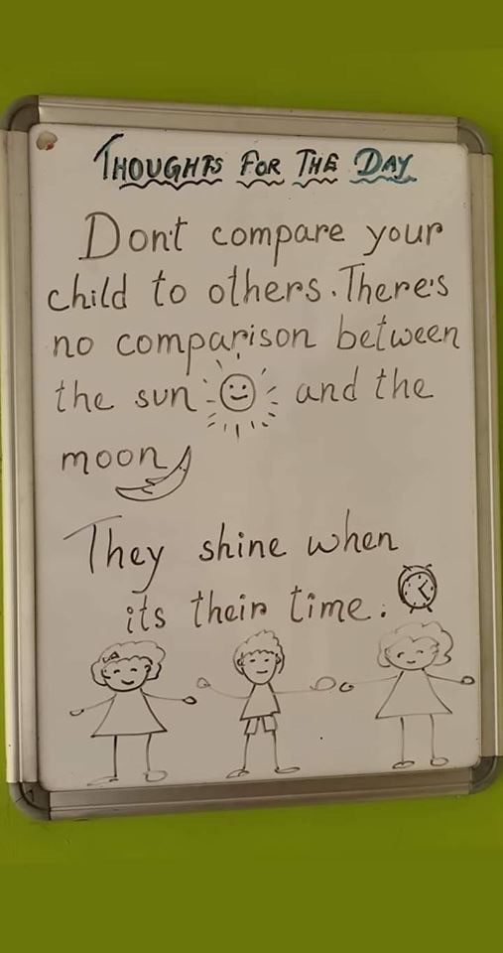

Slide 5
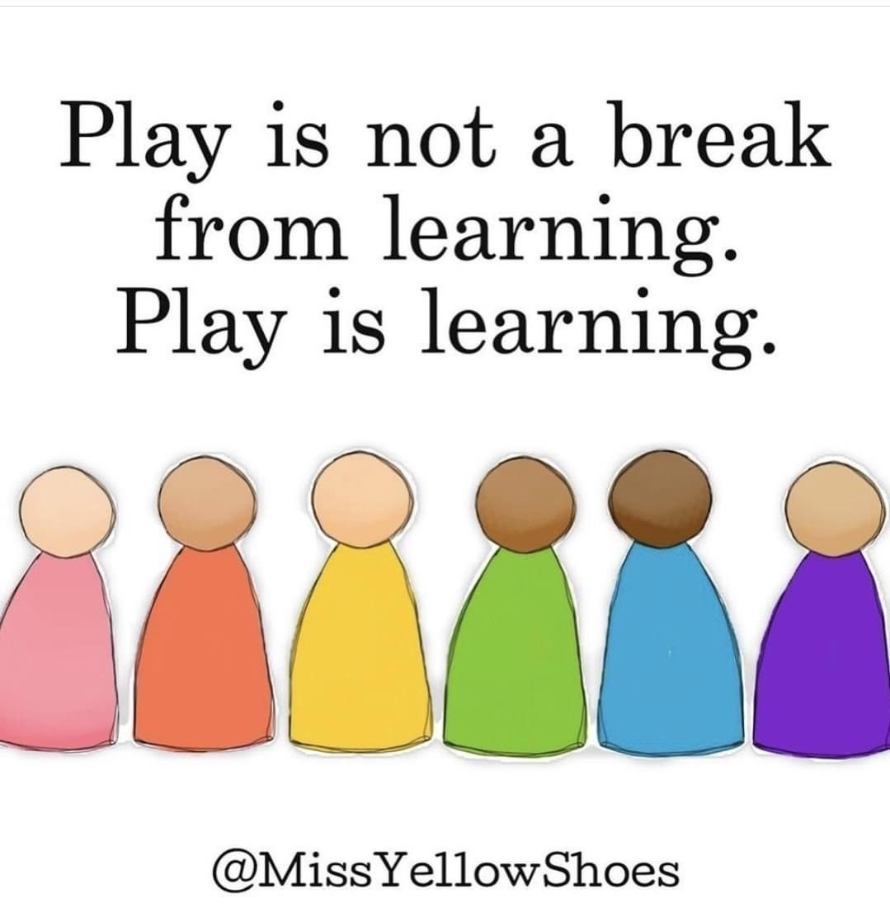

Slide 6
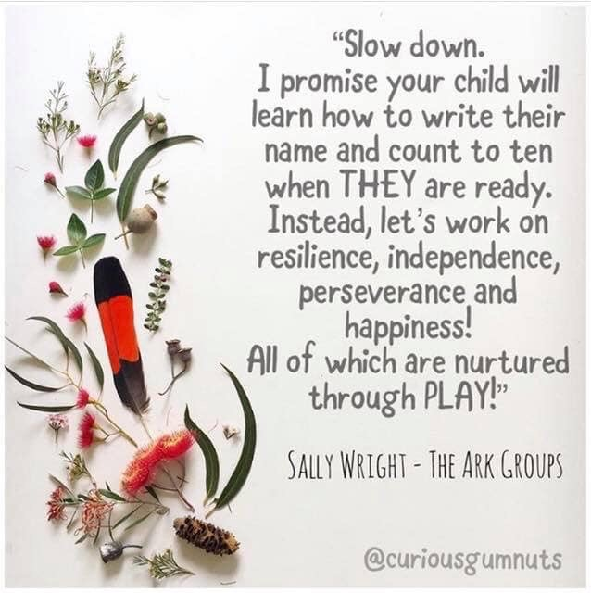

Slide 7


Slide 8


Slide 9
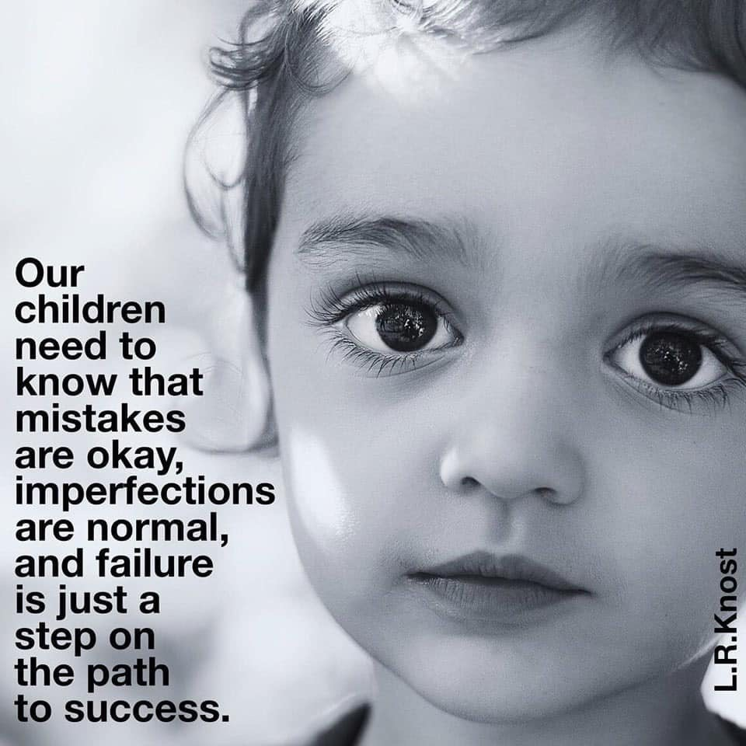

Slide 10
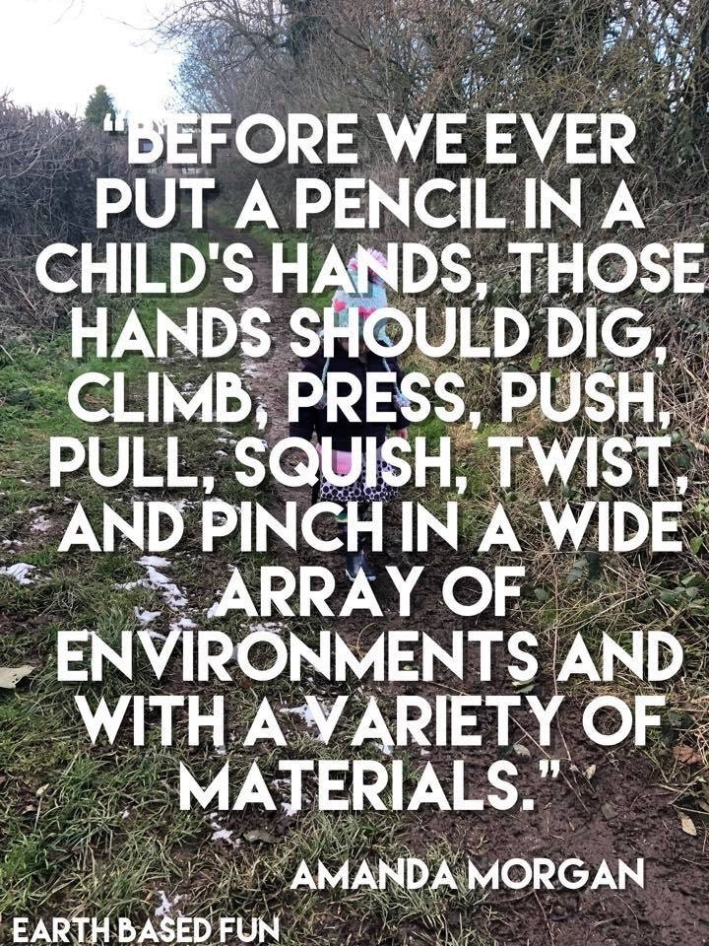

Slide 11
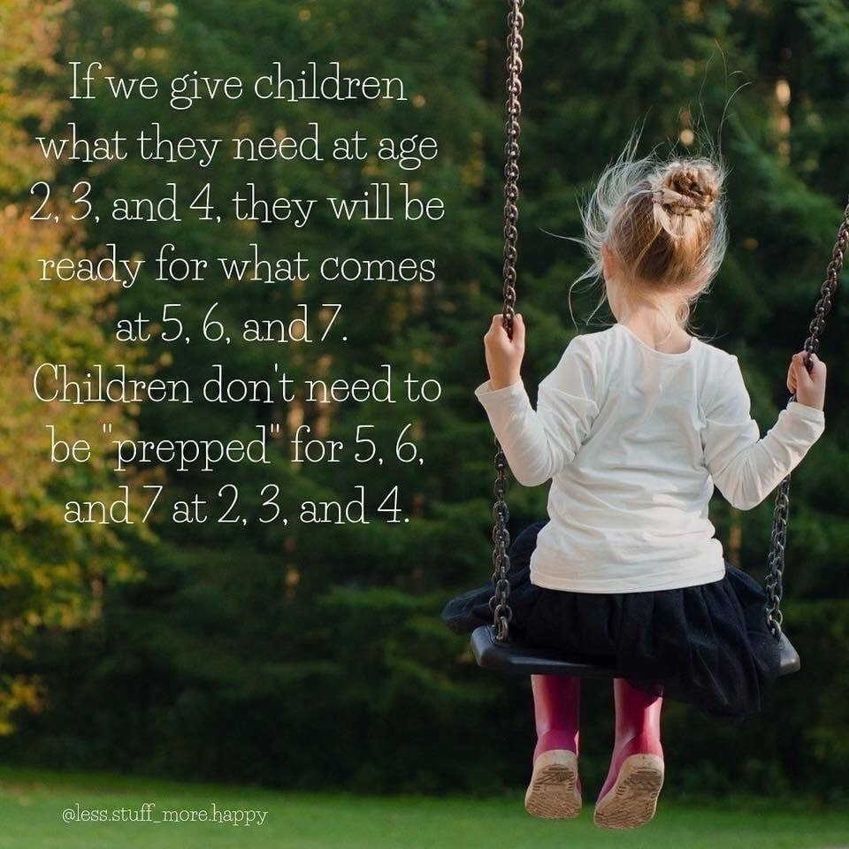

Slide 12
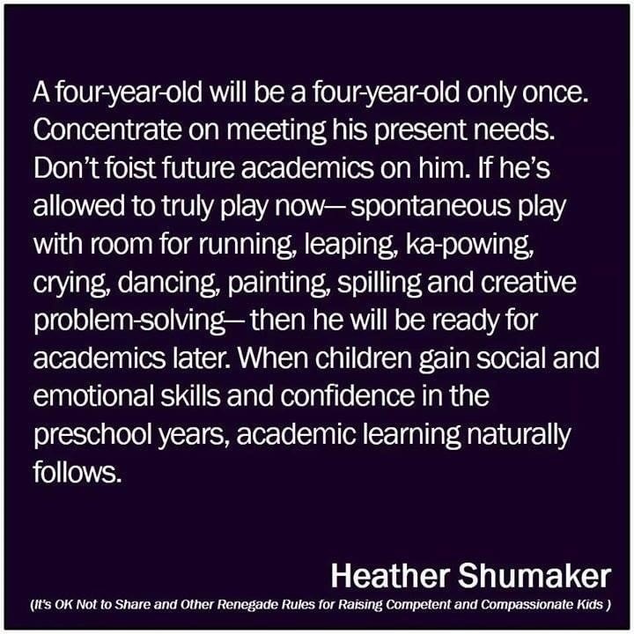

Slide 13
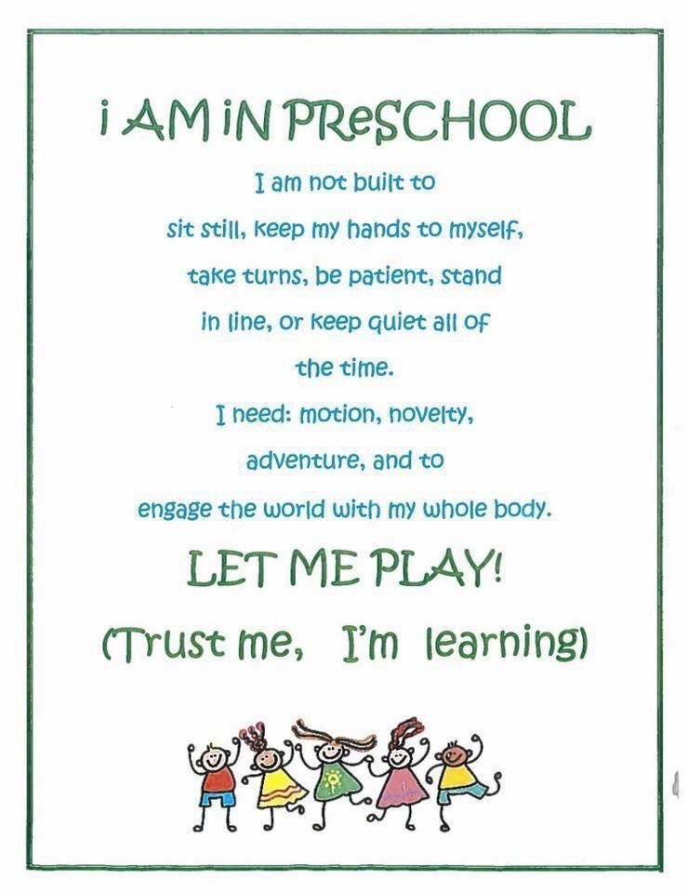

Slide 14
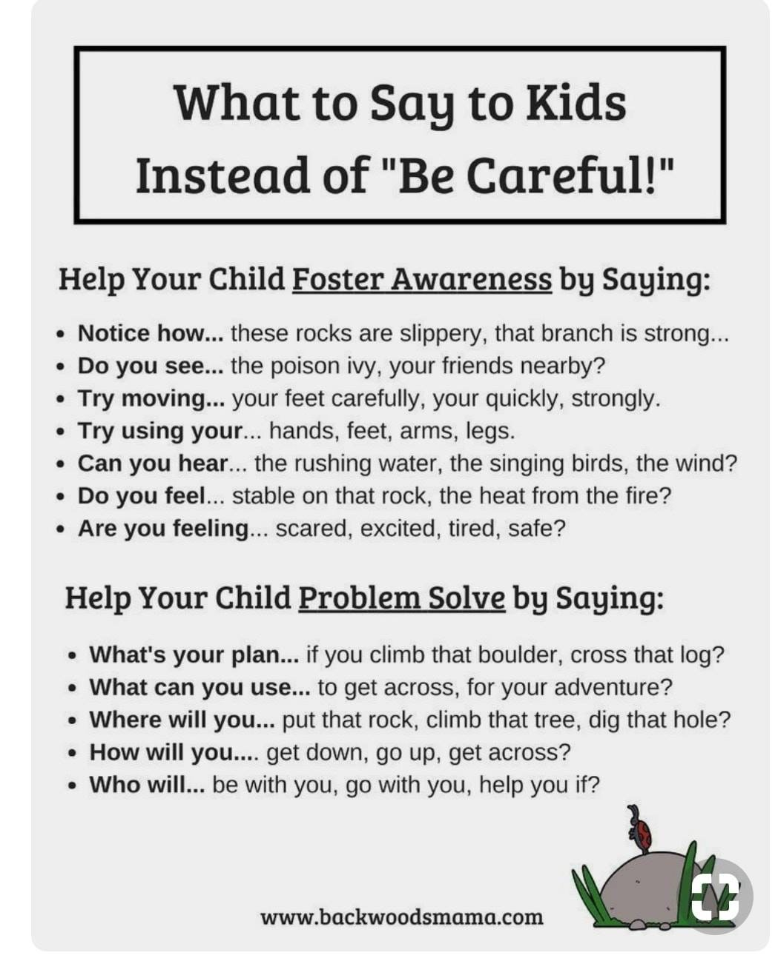

Slide 15
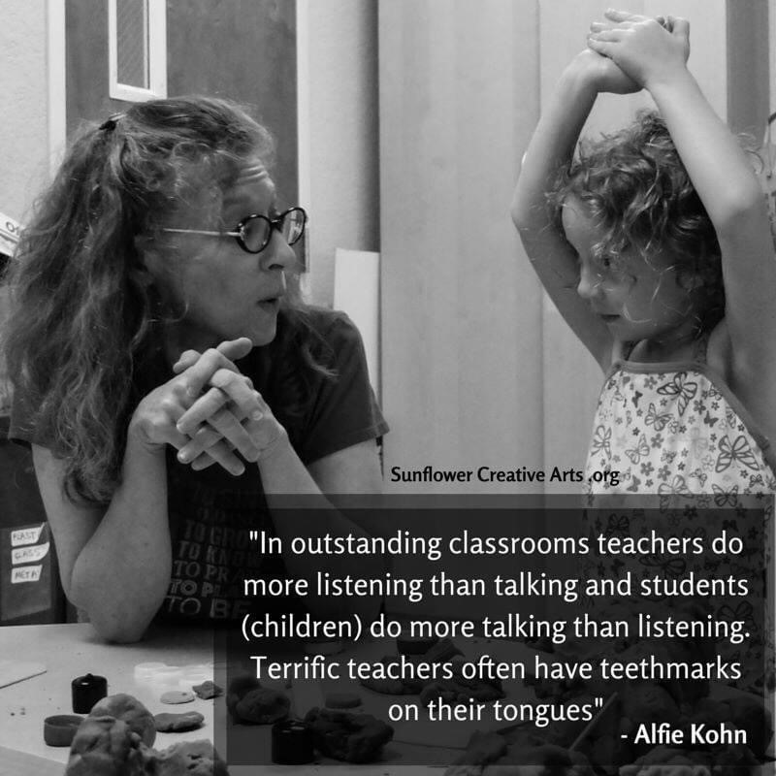

Slide 16


Slide 17
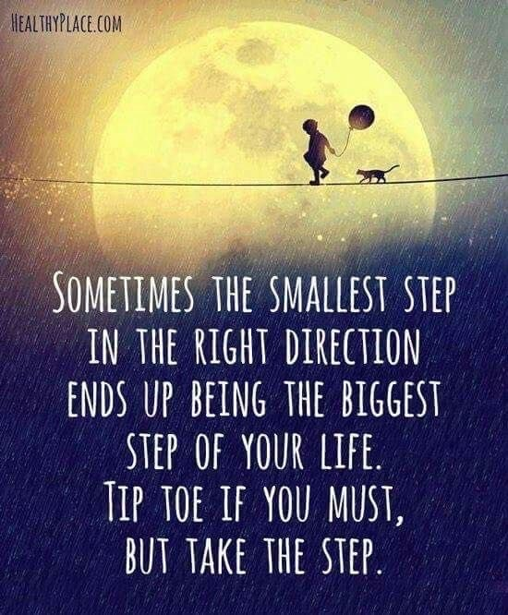

Slide 18
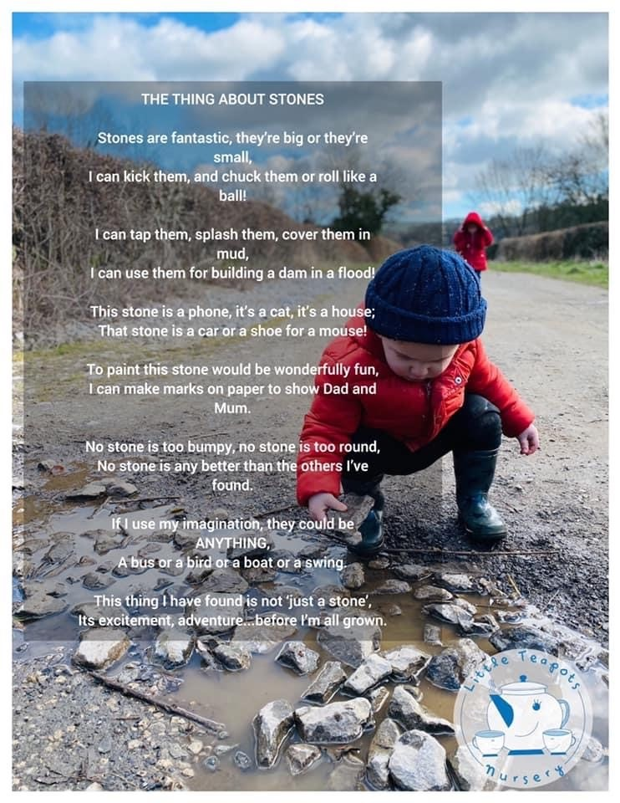

Slide 19


Slide 20
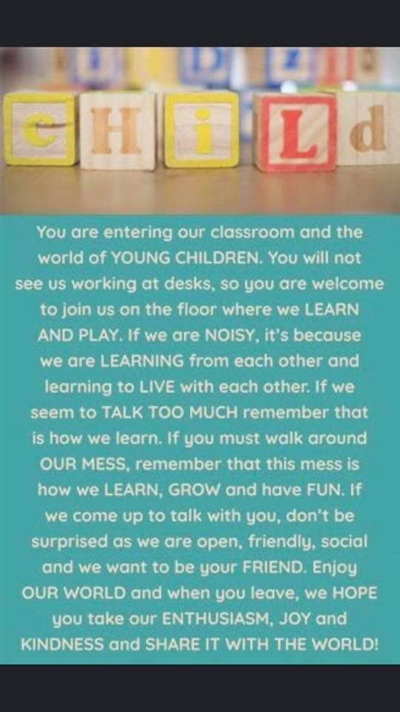

Slide 21
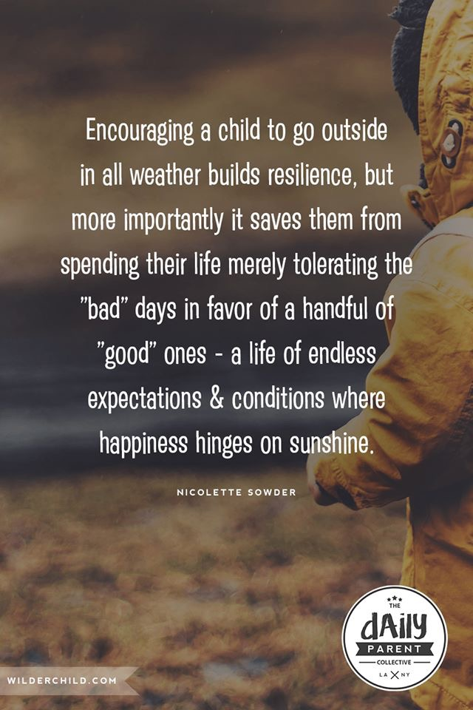

Slide 22


Slide 23
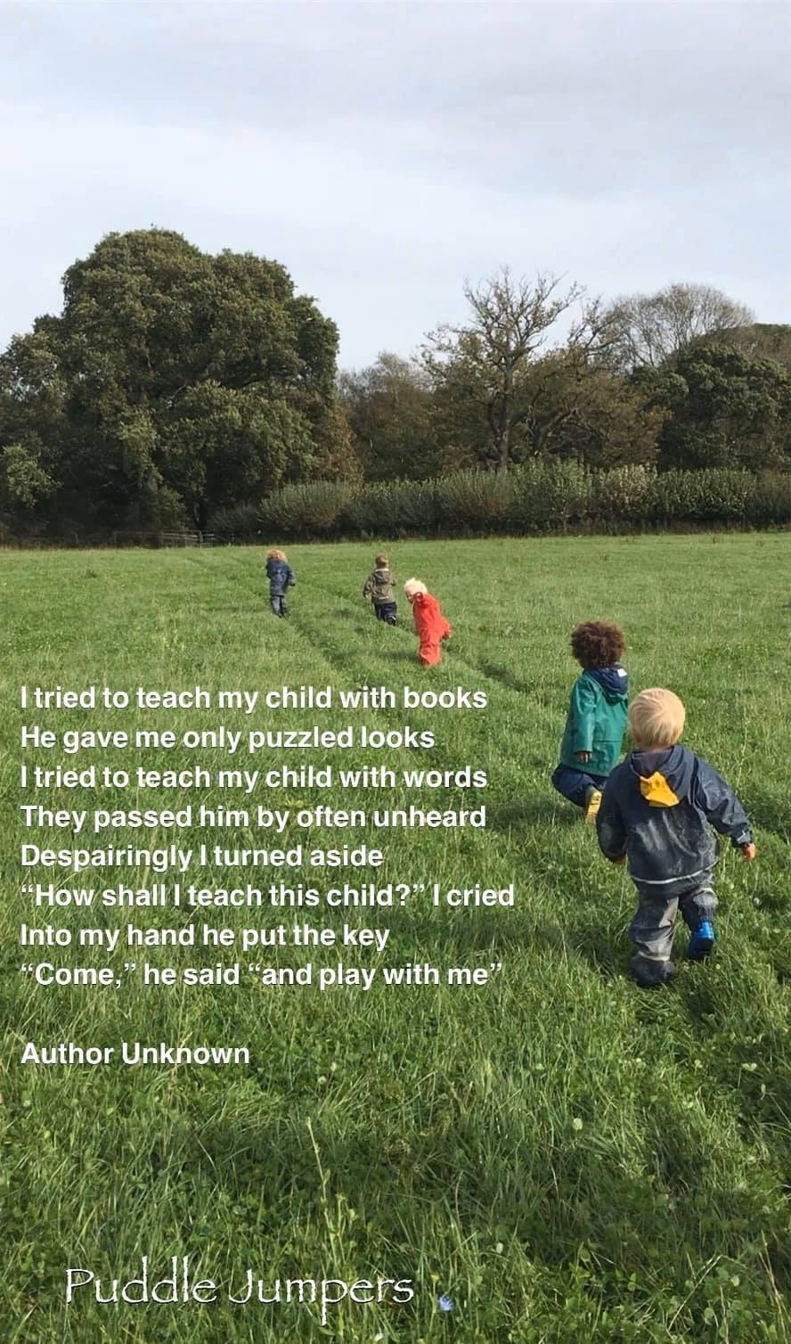

Slide 24


